Slide 1
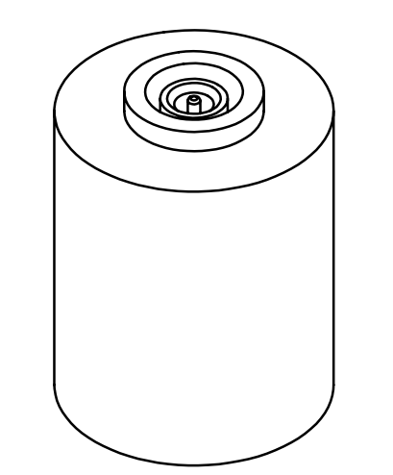
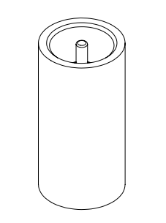
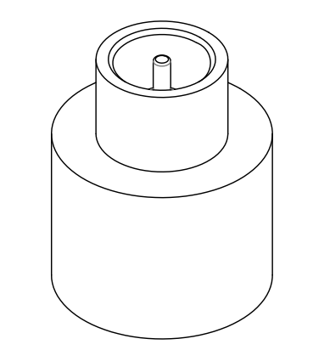
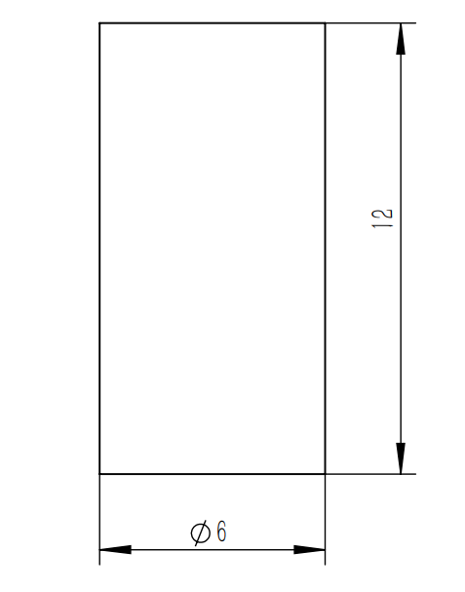
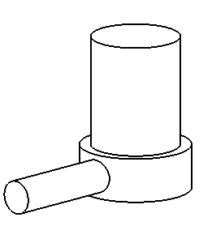
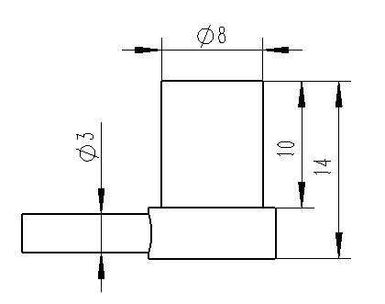
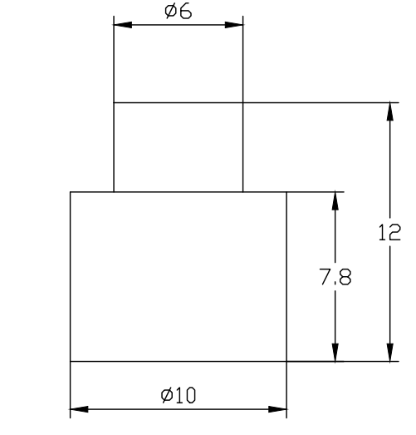
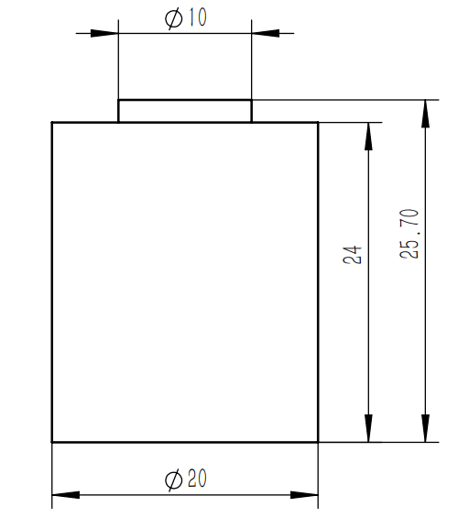
电容式微位移传感器数据手册
命名规则：
探头
P C 10-12 S - IN
Model
Material:
AL: Aluminum 6061
IN: Invar 36
ST: Stainless steel 316
SI: Super invar 32-5
Shape:
R: Rectangular
C: Cylindrical
Diameter (mm)
Connector type:
S: Straight
R: Right Angle
Body length (mm)
型号 | 形状 | 直径 | 探测区直径 | 长度 | 屏蔽厚度 | 材质 | 装夹方式
PC06-12S-IN |  | 6 | 2.3 | 12 | 0.9 | invar | 径向夹装
PC06-12R-IN |  | 6 | 2.3 | 12 | 0.9 | invar | 径向夹装
PC10-12S-IN |  | 10 | 5.8 | 12 | 1.5 | invar | 径向夹装
PC20-25S-IN |  | 20 | 14.3 | 25.7 | 2 | invar | 径向夹装

Slide 2
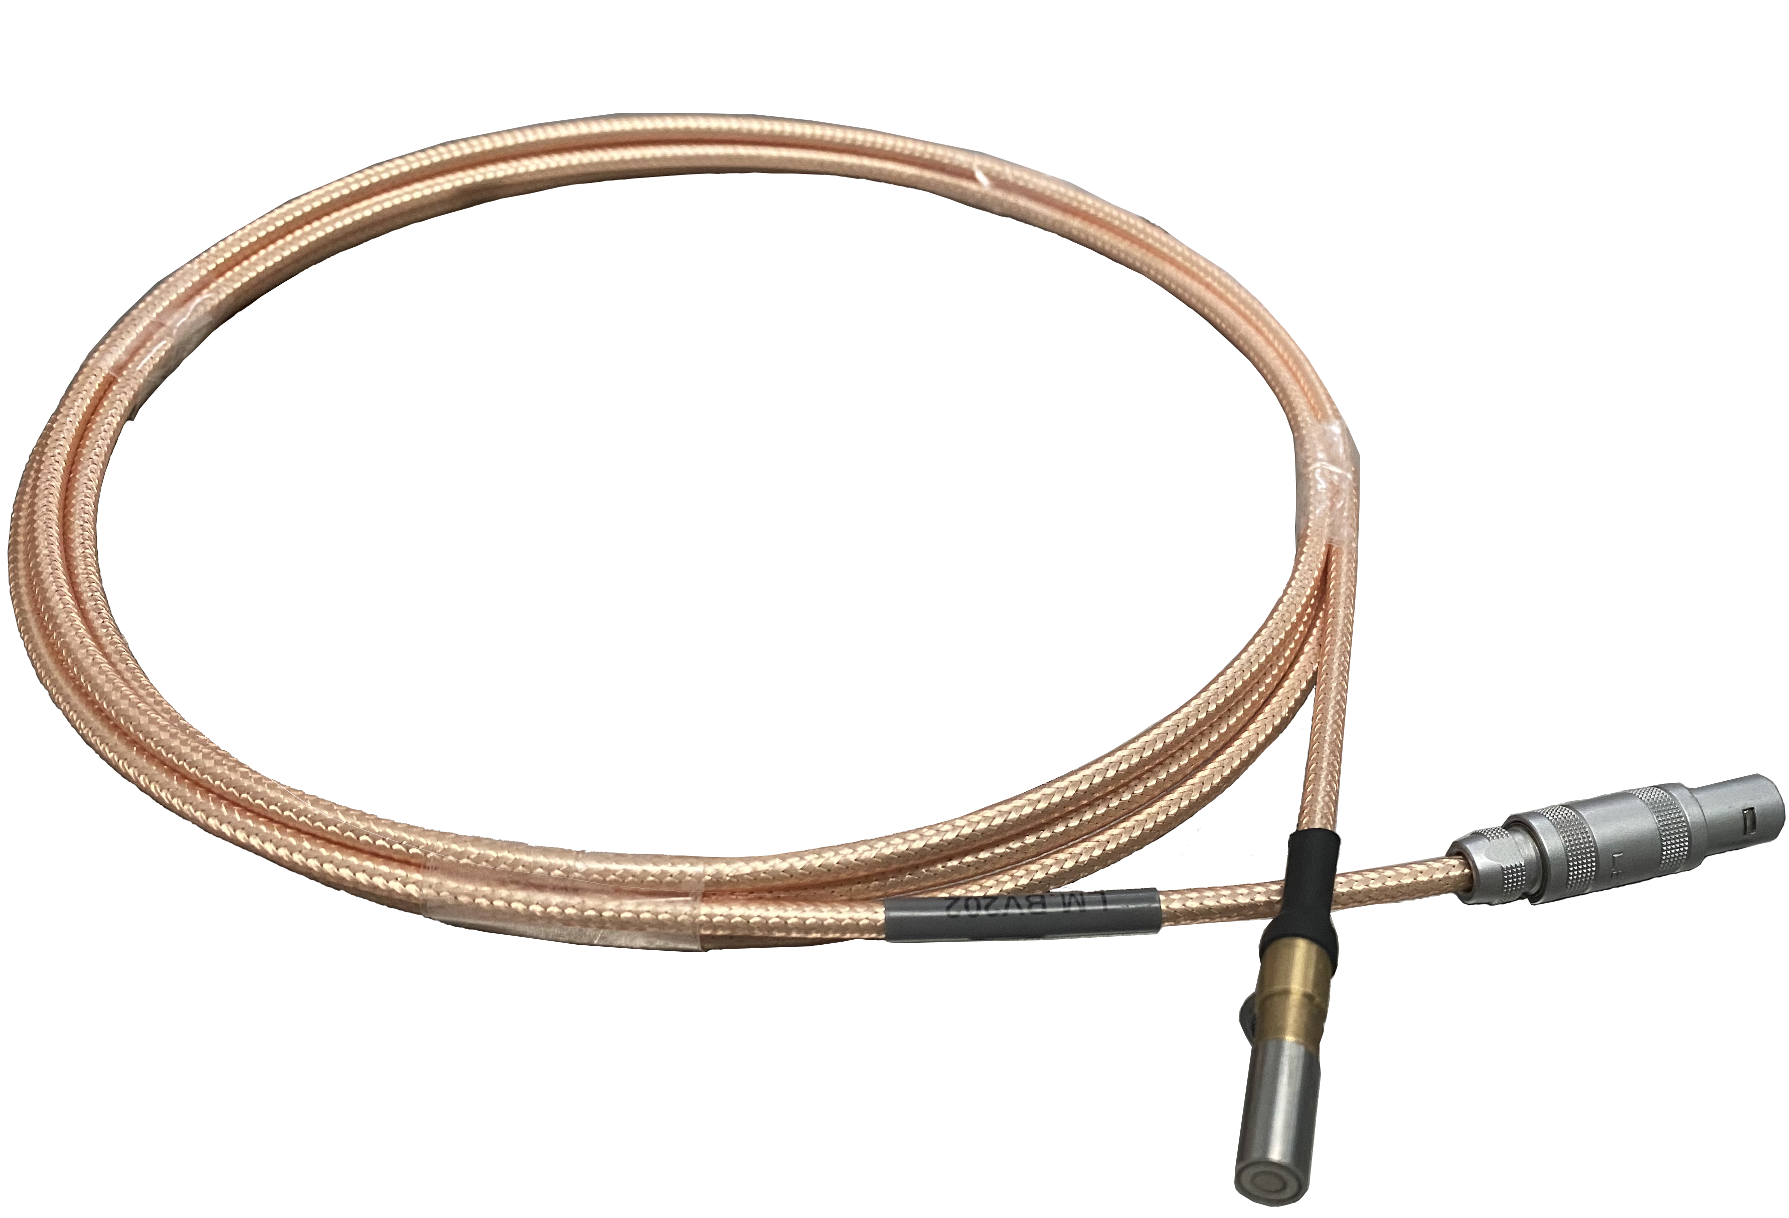
电容式微位移传感器数据手册
电缆
命名规则：
W V 35-200 D
Connector type:
C: Circular
A: Coaxial
D: D type
N: None
Model
Sheath:
N: NONE
V: PVC
U: PUR
E: PE
Length (cm)
Diameter (0.1mm)
传感器侧接口类别 | 型号 | 长度(m) | 直径(mm) | 探头侧安装 | 传感器侧接口 | 真空型号
Triaxial | WV35-150A | 1.5 | 3.5 | 插接 | LEMO FFA.0S.250 | WN35-150N
 | WV35-200A | 2 | 3.5 | 插接 | LEMO FFA.0S.250 | WN35-200N
 | WV35-250A | 2.5 | 3.5 | 插接 | LEMO FFA.0S.250 | WN35-250N
Circular | WV35-150C | 1.5 | 3.5 | 插接 | LEMO FFA.0S.304 | WN35-150N
 | WV35-200C | 2 | 3.5 | 插接 | LEMO FFA.0S.304 | WN35-200N
Circular | WV35-250C | 2.5 | 3.5 | 插接 | LEMO FFA.0S.304 | WN35-250N
D type | WV35-150D | 1.5 | 3.5 | 插接 | Dsub-5W1 | WN35-150N
 | WV35-200D | 2 | 3.5 | 插接 | Dsub-5W1 | WN35-200N
 | WV35-250D | 2.5 | 3.5 | 插接 | Dsub-5W1 | WN35-250N

Slide 3
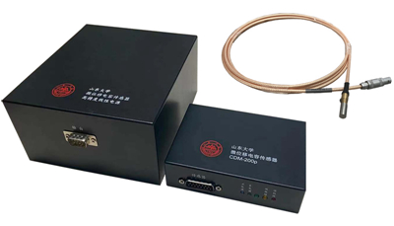
电容式微位移传感器数据手册
性能指标
探头分类 |  | 6mm/Cylindric | 10mm/Cylindric | 20mm/Cylindric
相关型号 |  | PC06-12X-XX | PC10-12X-XX | PC20-25X-XX
量程 |  | 100um | 200um | 2000um
分辨率 | 2Hz | 0.0195nm | 0.0357nm | 0.311nm
 | 25Hz | 0.0433nm | 0.0843nm | 0.775nm
 | 1kHz | 0.1411nm | 0.2691nm | 1.930nm
 | 2kKz | 0.3934nm | 0.7256nm | 3.525nm
线性度 |  | 0.15% | 0.15% | 0.15%
默认带宽 |  | 2kHz | 2kHz | 2kHz
重复性 |  | 0.21nm | 0.39nm | 3.3nm

